Slide 1

Rough reflection
Torch light reflects brightly off a mirror.
What happens when a torch is shone on other objects?
Ten Pence
10p
UYSEG
Bricks

Slide 2
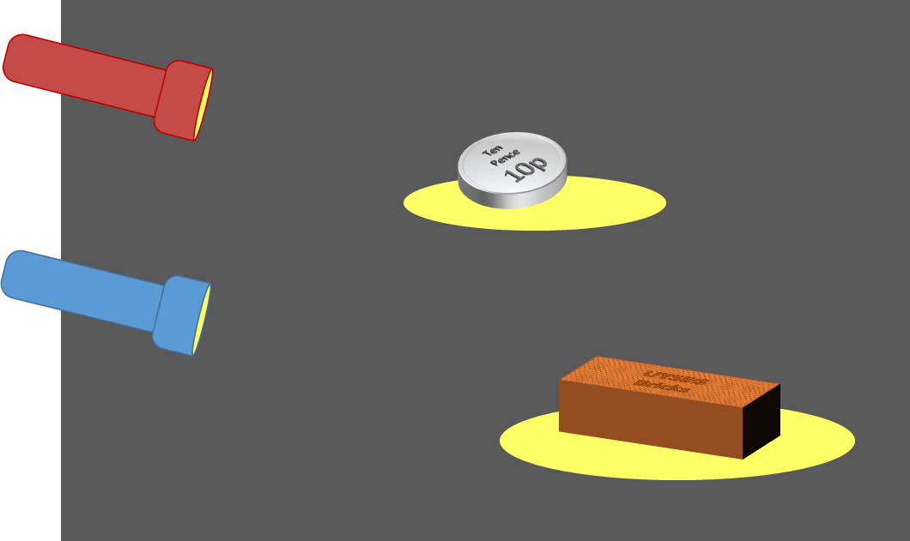
Rough reflection
What happens when a torch is shone on other objects?
I am sure this is right
I think this is right
I think this is wrong
I am sure this is wrong
A
Light reflects off the shiny coin
B
Light reflects off the coin like a mirror (all in one direction)
C
Light reflects off the dull brick
D
The rough surface of the brick reflects light in all directions

